Slide 1
Brief Description On Labeled Data:
Our main aim is to detect anomalies by applying HTM algorithm using HTM studio. We successfully labeled pit stops, unknown anomalies and crashes. Then we tried to find the reason for unknown anomalies with the help of domain expert.
HTM studio is a tool which was developed by Numenta’s HTM community to detect anomalies in the simplest way. It has a particular data format which is “yyyy-mm-dd hh:mm:ss.SSS” with only one metric for further analysis. Rpm of the racing car was the metric we used.
After analysis, it detects the anomalies and it displays them in red, green, and yellow bars. A red bar means the anomaly at that time period is high. Yellow means the anomaly at that time period is medium. Green is normal.

Slide 2
We run anomaly detection for all the 33 cars using HTM studio. Then we followed the following steps.
For Crash:-
1) If two cars RPM drastically reduced to zero at the same timestamp, then we considered it as a crash.
2) If a single car's RPM reduced to zero then it might be engine breakdown or a car hitting the wall because of tire failure.
For Pitstop:-
1)Usually, a pitstop lasts for 40 seconds of which rpm will be zero for 14 seconds. On an average, the cars move with a speed of around 220 mph. But at the time of pitstop, the RPM reduces to zero and gets back to it’s normal value. Whenever such variation in the RPM is seen we label it as a known anomaly. For every car there are 6 pit stops.
For Unknown:-
1) If an unexpected event occurs then we say it as unknown anomaly. Only with help of domain knowledge we can know the reason why it occurred.
We used video record for validation.

Slide 3
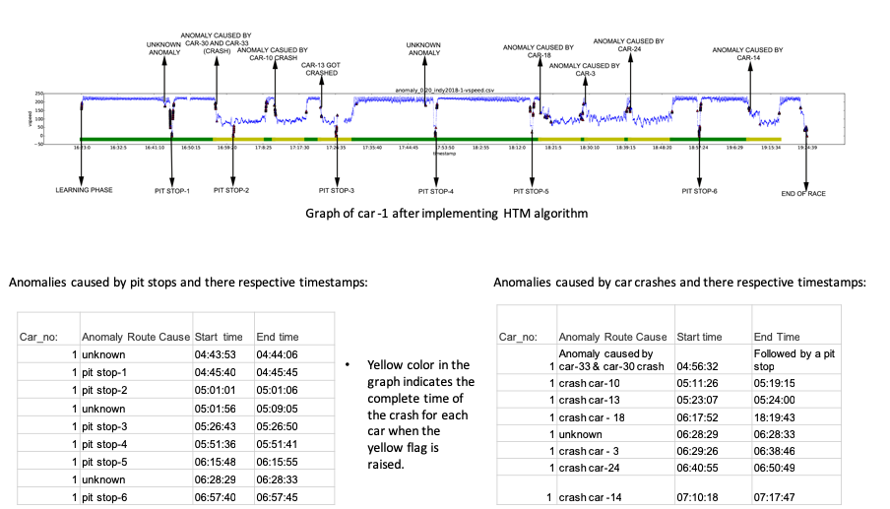

Slide 4
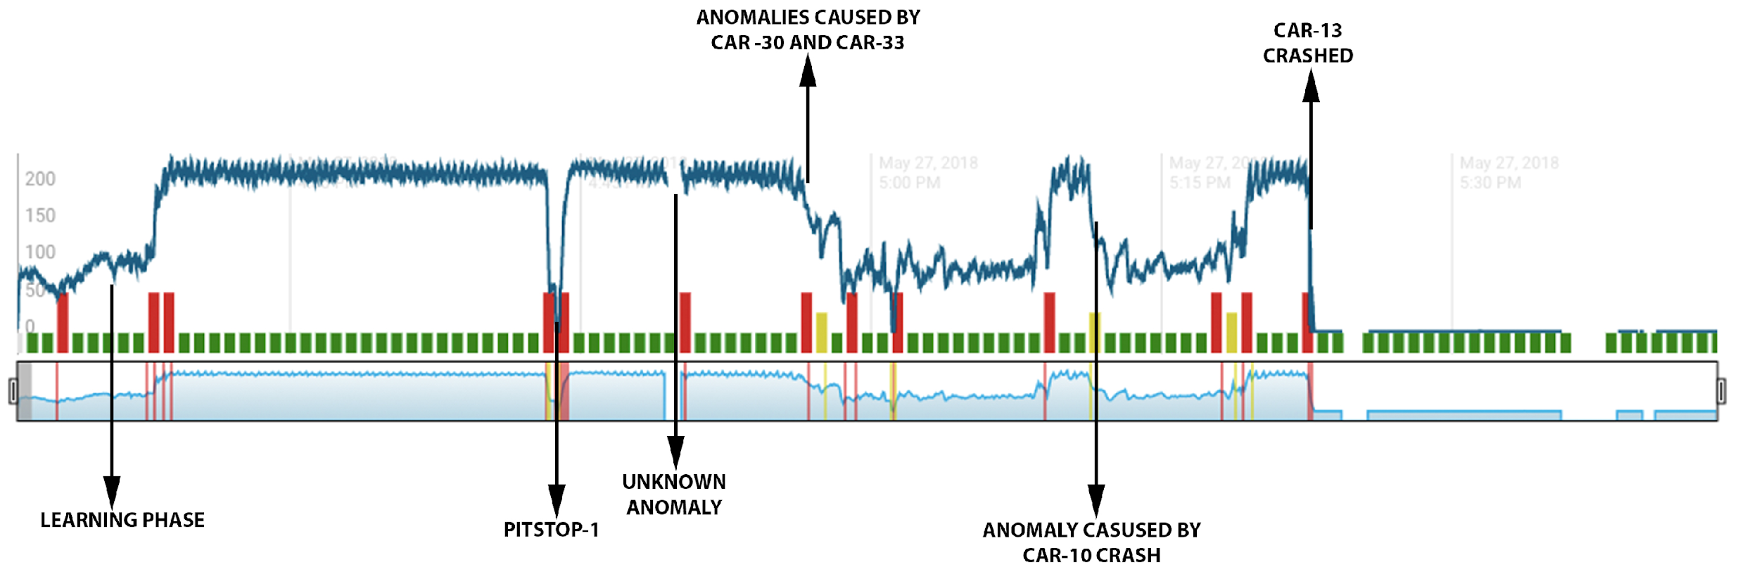
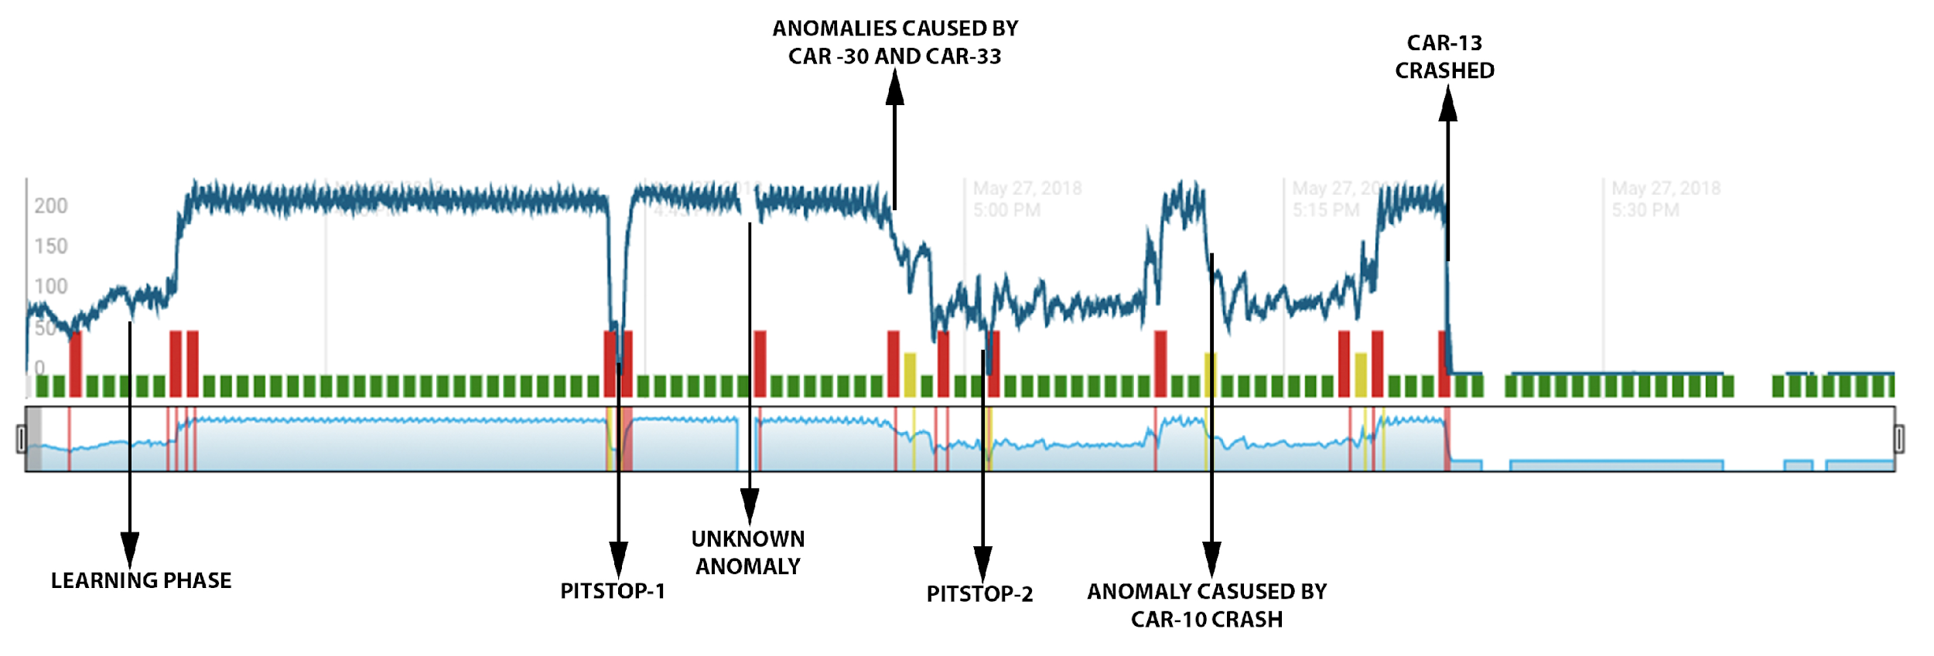
Graph of car -13 after implementing HTM algorithm
Anomalies caused by pit stops and there respective timestamps:
Anomalies caused by car crashes and there respective timestamps:
Car_no: | Anomaly Route Cause | Start time | End time
13 | pit stop-1 | 16:43:48.48 | 16:43:52.52
13 | unknown | 16:49:25.25 | 16:50:12.12
13 | pit stop-2 | 17:01:08.08 | 17:01:12.12
Car_no: | Anomaly Route Cause | Start time | End Time
13 | Anomaly caused by car-33 & car-30 crash | 16:56:32 | Followed by a pit stop
13 | crash car-10 | 17:11:26 | 17:19:15
13 | crash car-13 | 17:23:07 | 17:24:00

Slide 5
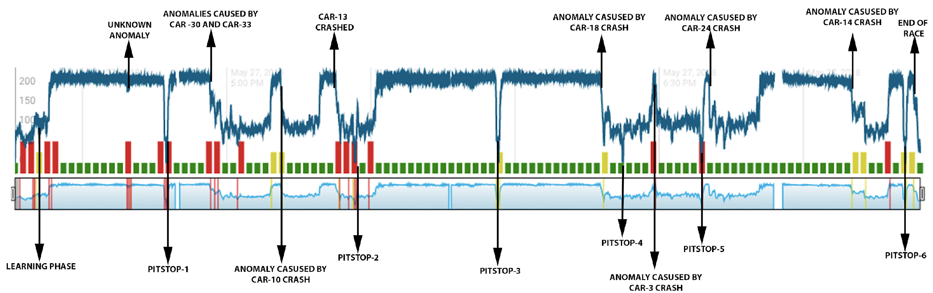
Graph of car -19 after implementing HTM algorithm
Anomalies caused by pit stops and there respective timestamps:
Anomalies caused by car crashes and there respective timestamps:
Car_no: | Anomaly Route Cause | Start time | End time
19 | unknown | 16:39:17.17 | 16:39:50.50
19 | pit stop-1 | 16:47:25.25 | 16:47:31.31
19 | pit stop-2 | 17:26:40.40 | 17:26:52.52
19 | pit stop-3 | 17:56:34.34 | 17:56:37.37
19 | pit stop-4 | 18:22:24.24 | 18:22:31.31
19 | pit stop-5 | 18:38:48.48 | 18:38:56.56
19 | pit stop-6 | 19:21:14.14 | 19:21:17.17
Car_no: | Anomaly Route Cause | Start time | End Time
19 | Anomaly caused by car-33 & car-30 crash | 16:56:32 | Followed by a pit stop
19 | crash car-10 | 17:11:26 | 17:19:15
19 | crash car-13 | 17:23:07 | 17:24:00
19 | crash car - 18 | 18:17:52 | 18:19:43
19 | crash car - 3 | 18:29:26 | 18:38:46
19 | crash car-24 | 18:40:55 | 18:50:49
19 | crash car -14 | 19:10:18 | 19:17:47

Slide 6
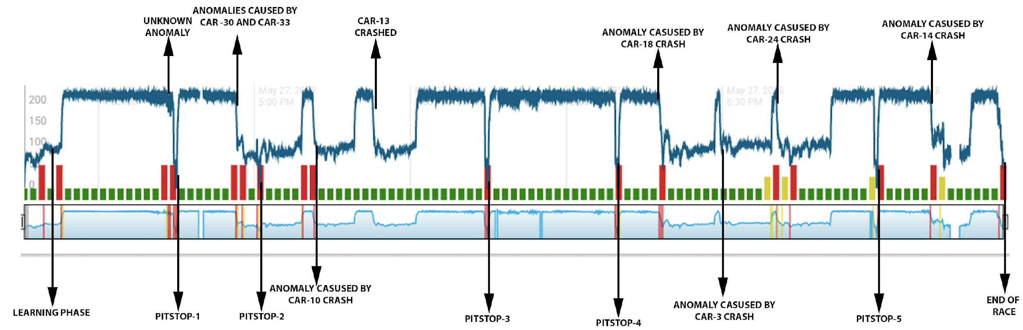
Graph of car -20 after implementing HTM algorithm
Anomalies caused by pit stops and there respective timestamps:
Anomalies caused by car crashes and there respective timestamps:
Car_no: | Anomaly Route Cause | Start time | End time
20 | unknown | 16:43:27.27 | 16:43:42.42
20 | pit stop-1 | 16:44:57.57 | 16:45:04.04
20 | pit stop-2 | 17:01:01.01 | 17:01:07.07
20 | pit stop-3 | 17:44:50.50 | 17:44:57.57
20 | pit stop-4 | 18:09:53.53 | 18:09:58.58
20 | pit stop-5 | 18:59:38.38 | 18:59:41.41
20 | pit stop-6 | Missing data | Missing data
Car_no: | Anomaly Route Cause | Start time | End Time
20 | Anomaly caused by car-33 & car-30 crash | 16:56:32 | Followed by a pit stop
20 | crash car-10 | 17:11:26 | 17:19:15
20 | crash car-13 | 17:23:07 | 05:24:00
20 | crash car - 18 | 18:17:52 | 18:19:43
20 | crash car - 3 | 18:29:26 | 18:38:46
20 | crash car-24 | 18:40:55 | 18:50:49
20 | crash car -14 | 19:10:18 | 19:17:47

Slide 7
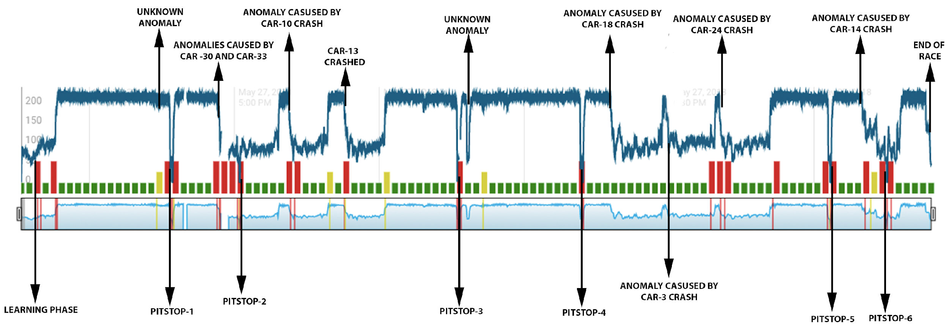
Graph of car -21 after implementing HTM algorithm
Anomalies caused by pit stops and there respective timestamps:
Anomalies caused by car crashes and there respective timestamps:
Car_no: | Anomaly Route Cause | Start time | End time
21 | unknown | 16:43:53 | 16:44:06
21 | pit stop-1 | 16:47:07.07 | 16:47:14.14
21 | pit stop-2 | 17:01:04.04 | 17:01:09.09
21 | pit stop-3 | 17:46:10.10(missing data) | 17:26:50
21 | pit stop-4 | 18:12:03.03 | 18:12:10.10
21 | pit stop-5 | 19:03:21.21 | 19:03:28.28
21 | unknown | 17:48:04.04 | 17:48:54.54
21 | pit stop-6 | 19:15:05.05 | 19:15:10.10
Car_no: | Anomaly Route Cause | Start time | End Time
21 | Anomaly caused by car-33 & car-30 crash | 16:56:32 | Followed by a pit stop
21 | crash car-10 | 17:11:26 | 17:19:15
21 | crash car-13 | 17:23:07 | 17:24:00
21 | crash car - 18 | 18:17:52 | 18:19:43
21 | crash car - 3 | 18:29:26 | 18:38:46
21 | crash car-24 | 18:40:55 | 18:50:49
21 | crash car -14 | 19:10:18 | 19:17:47

Slide 8
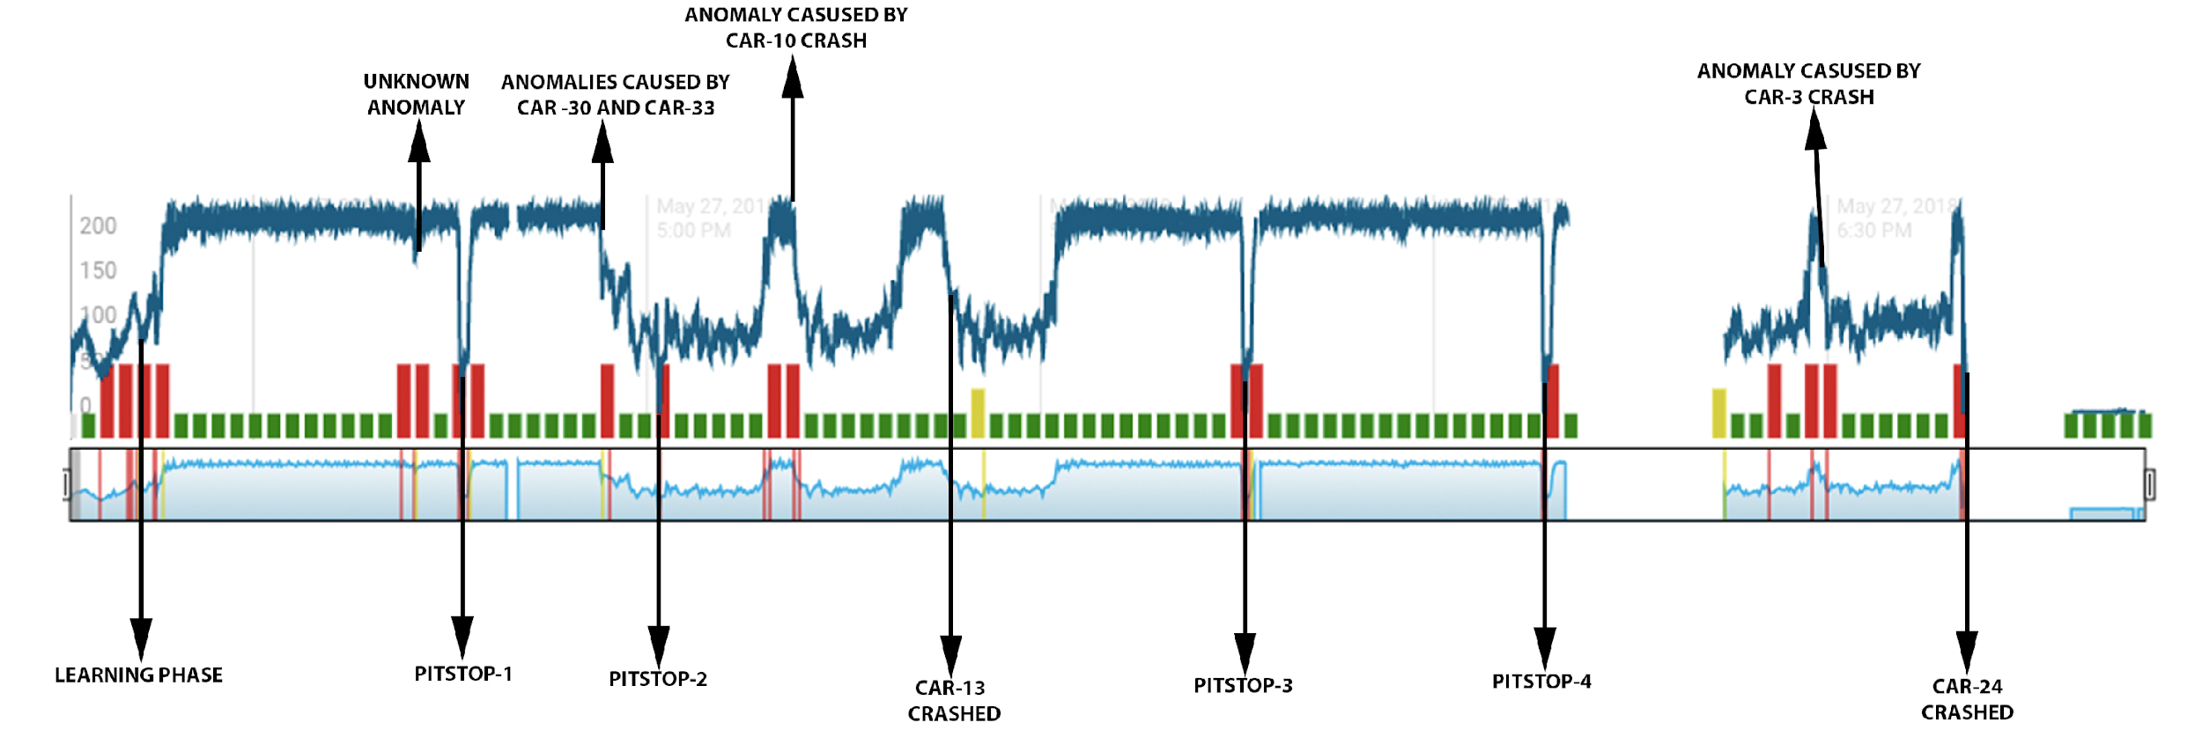
Graph of car -24 after implementing HTM algorithm
Anomalies caused by pit stops and there respective timestamps:
Anomalies caused by car crashes and there respective timestamps:
Car_no: | Anomaly Route Cause | Start time | End time
24 | unknown | 16:42:18.18 | 16:42:31.31
24 | pit stop-1 | 16:45:51.51 | 16:45:57.57
24 | pit stop-2 | 17:00:54.54 | 17:01:01.01
24 | pit stop-3 | 17:45:32.32 | 17:45:40.40
24 | pit stop-4 | 18:08:23.23 | 18:08:29.29
Car_no: | Anomaly Route Cause | Start time | End Time
24 | Anomaly caused by car-33 & car-30 crash | 16:56:32 | Followed by a pit stop
24 | crash car-10 | 17:11:26 | 17:19:15
24 | crash car-13 | 17:23:07 | 17:24:00
24 | crash car - 18 | 18:17:52 | 18:19:43
24 | unknown | 18:28:29 | 18:28:33
24 | crash car - 3 | 18:29:26 | 18:38:46
24 | crash car-24 | 18:40:55 | 18:50:49

Slide 9
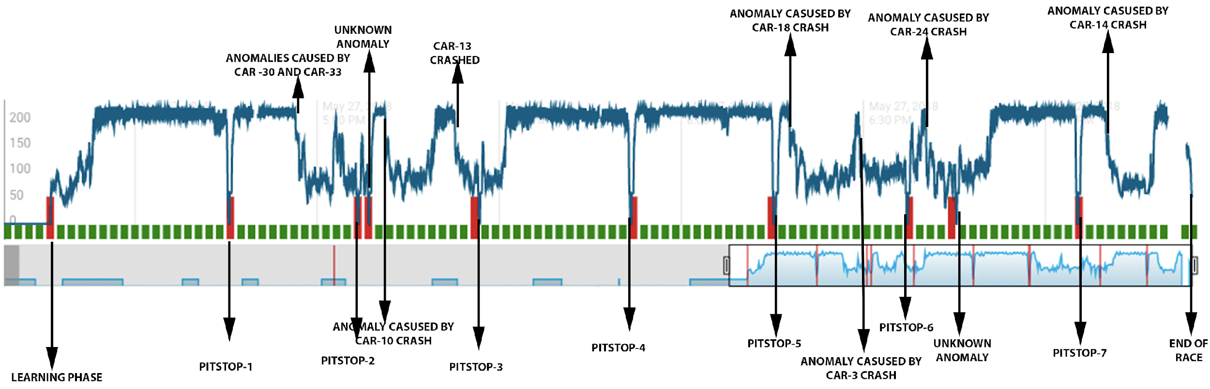
Graph of car -26 after implementing HTM algorithm
Anomalies caused by pit stops and there respective timestamps:
Anomalies caused by car crashes and there respective timestamps:
Car_no: | Anomaly Route Cause | Start time | End time
26 | unknown | 04:43:53 | 04:44:06
26 | pit stop-1 | 16:45:27.45 | 16:45:33.08
26 | pit stop-2 | 17:06:40.69 | 17:06:47.36
26 | unknown | 17:08:31.82 | 17:08:33.60
26 | pit stop-3 | 17:26:42.85 | 17:26:48.51
26 | pit stop-4 | 17:51:35.85 | 17:51:45.45
26 | pit stop-5 | 18:15:15.05 | 18:15:33.23
26 | pit stop -6 | 06:28:29 | 18:37:17.16
26 | unknown | 18:45:21.41 | 18:45:23.28
Car_no: | Anomaly Route Cause | Start time | End Time
26 | Anomaly caused by car-33 & car-30 crash | 16:56:32 | Followed by a pit stop
26 | crash car-10 | 17:11:26 | 17:19:15
26 | crash car-13 | 17:23:07 | 17:24:00
26 | crash car - 18 | 18:17:52 | 18:19:43
26 | unknown | 18:28:29 | 18:28:33
26 | crash car - 3 | 18:29:26 | 18:38:46
26 | crash car-24 | 18:40:55 | 18:50:49
26 | crash car -14 | 19:10:18 | 19:17:47
26 | unknown | 19:05:21.24 | 18:05:22.86

Slide 10
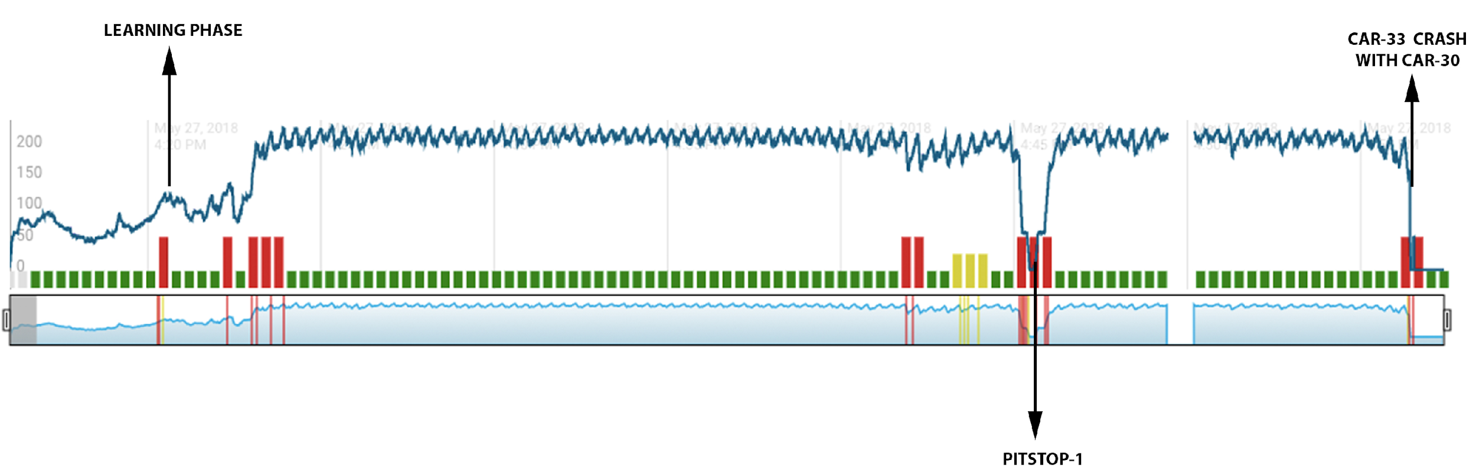
Graph of car -33 after implementing HTM algorithm
Anomalies caused by pit stops and there respective timestamps:
Anomalies caused by car crashes and there respective timestamps:
Car_no: | Anomaly Route Cause | Start time | End time
33 | unknown | 16:42:15.15 | 16:44:01.01
33 | pit stop-1 | 16:45:27.27 | 16:45:32.32
Car_no: | Anomaly Route Cause | Start time | End Time
33 | Anomaly caused by car-33 & car-30 crash | 16:56:32 | --

Slide 11
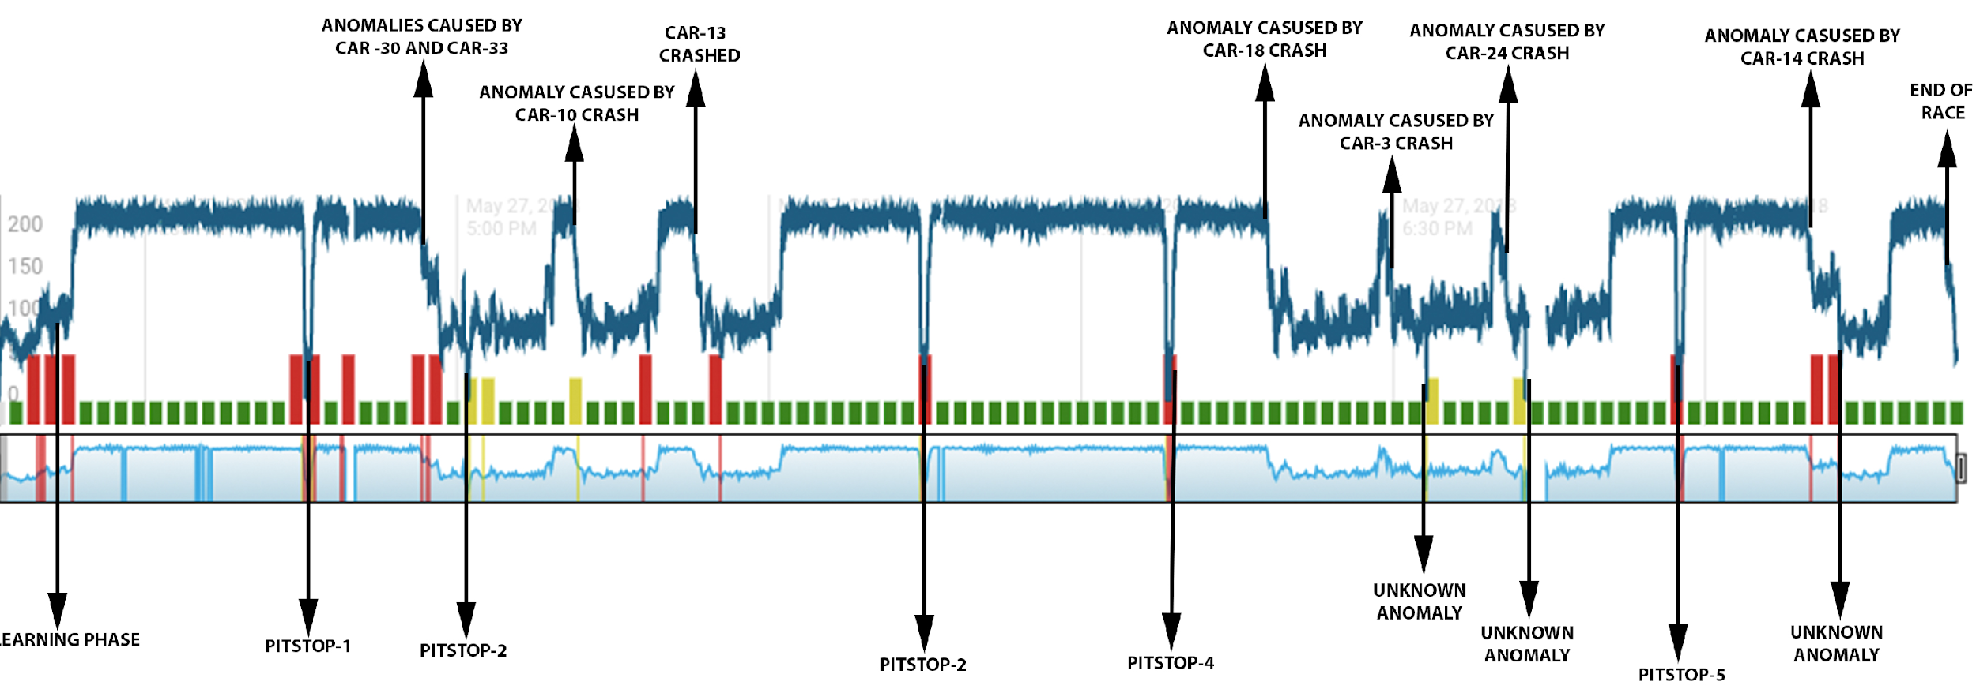
Graph of car -98 after implementing HTM algorithm
Anomalies caused by pit stops and there respective timestamps:
Anomalies caused by car crashes and there respective timestamps:
Car_no: | Anomaly Route Cause | Start time | End time
98 | unknown | 18:33:10.10 | 18:33:12.1
98 | pit stop-1 | 16:45:38.38 | 16:45:43.43
98 | pit stop-2 | 17:00:58.5 | 17:01:05.05
98 | unknown | 18:42:39.39 | 18:42:41.41
98 | pit stop-3 | 17:44:52.52 | 17:44:58.58
98 | pit stop-4 | 18:08:27.2 | 18:08:32.3
98 | pit stop-5 | 18:57:31.31 | 18:57:37.37
98 | unknown | 19:12:52.52 | 19:18:40.40
Car_no: | Anomaly Route Cause | Start time | End Time
98 | Anomaly caused by car-33 & car-30 crash | 16:56:32 | Followed by a pit stop
98 | crash car-10 | 17:11:26 | 17:19:15
98 | crash car-13 | 17:23:07 | 17:24:00
98 | crash car - 18 | 18:17:52 | 18:19:43
98 | unknown | 18:28:29 | 18:28:33
98 | crash car - 3 | 18:29:26 | 18:38:46
98 | crash car-24 | 18:40:55 | 18:50:49
98 | crash car -14 | 19:10:18 | 19:17:47

Slide 12
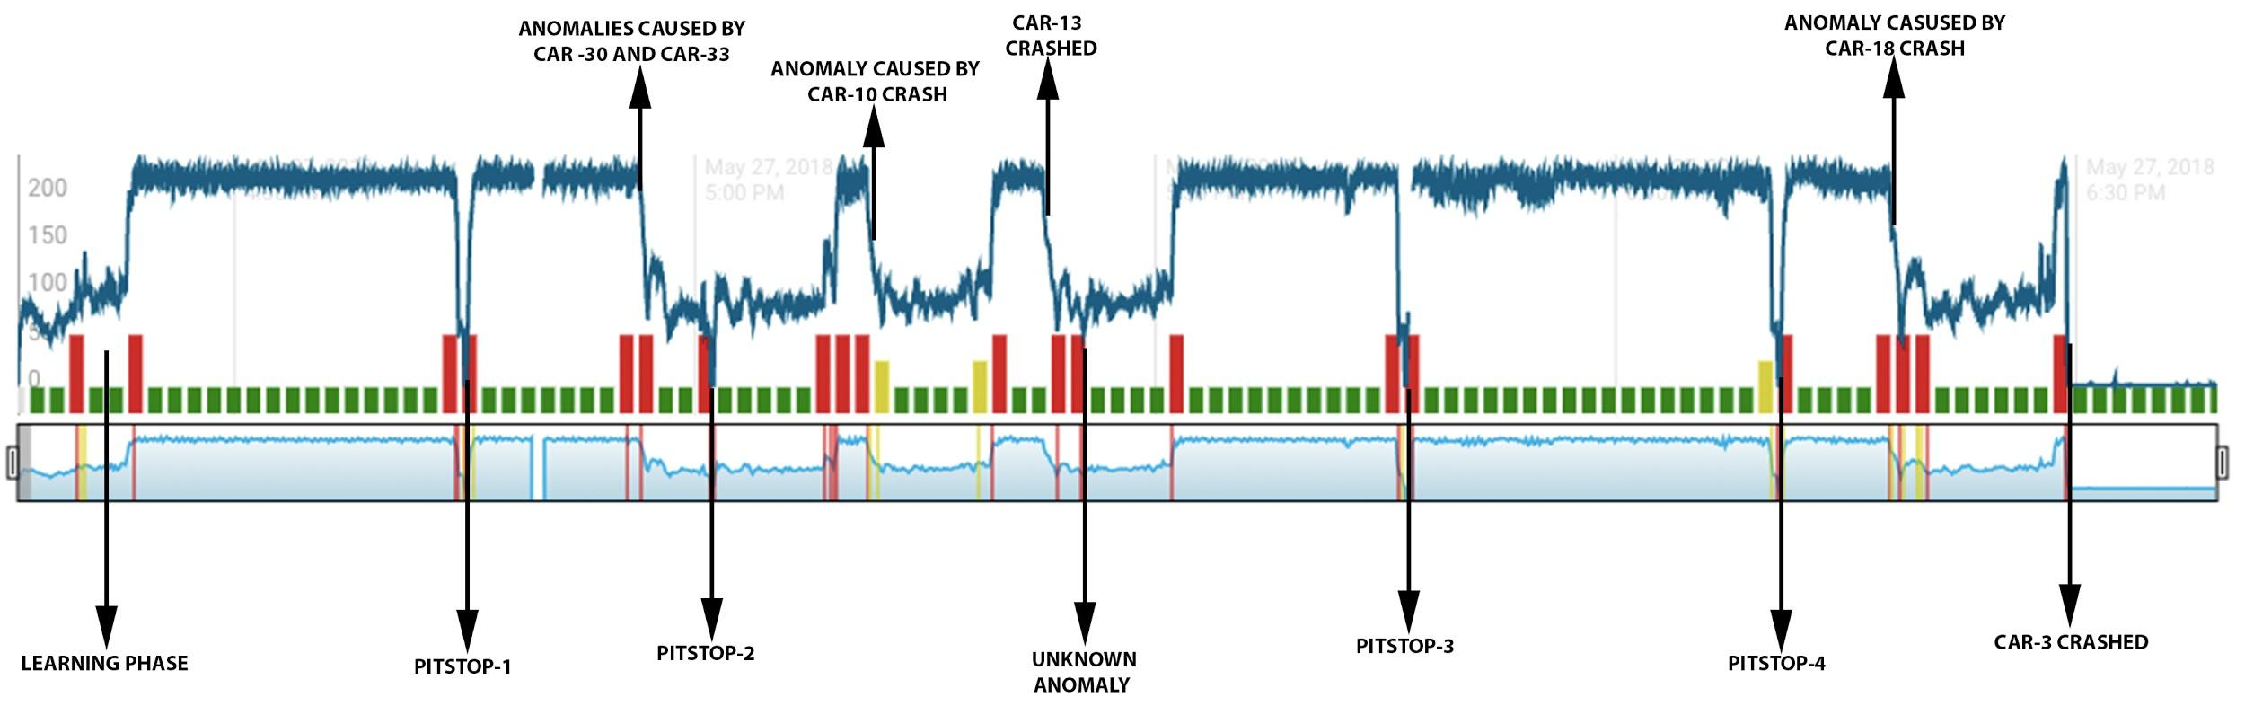
Graph of car -3 after implementing HTM algorithm
Anomalies caused by pit stops and there respective timestamps:
Anomalies caused by car crashes and there respective timestamps:
Car_no: | Anomaly Route Cause | Start time | End time
3 | unknown | 17:25:51.51 | 17:28:05.05
3 | pit stop-1 | 16:45:00.00 | 16:45:31.31
3 | pit stop-2 | 17:01:02.02 | 17:01:49.49
3 | pit stop-3 | 17:46:14.14 | 17:46:47.47
3 | pit stop-4 | 18:10:35.35 | 18:11:06.06
Car_no: | Anomaly Route Cause | Start time | End Time
3 | Anomaly caused by car-33 & car-30 crash | 16:56:32 | Followed by a pit stop
3 | crash car-10 | 17:11:26 | 17:19:15
3 | crash car-13 | 17:23:07 | 17:24:00
3 | crash car - 18 | 18:17:52 | 18:19:43
3 | crash car - 3 | 18:29:26 | 18:38:46

Slide 13
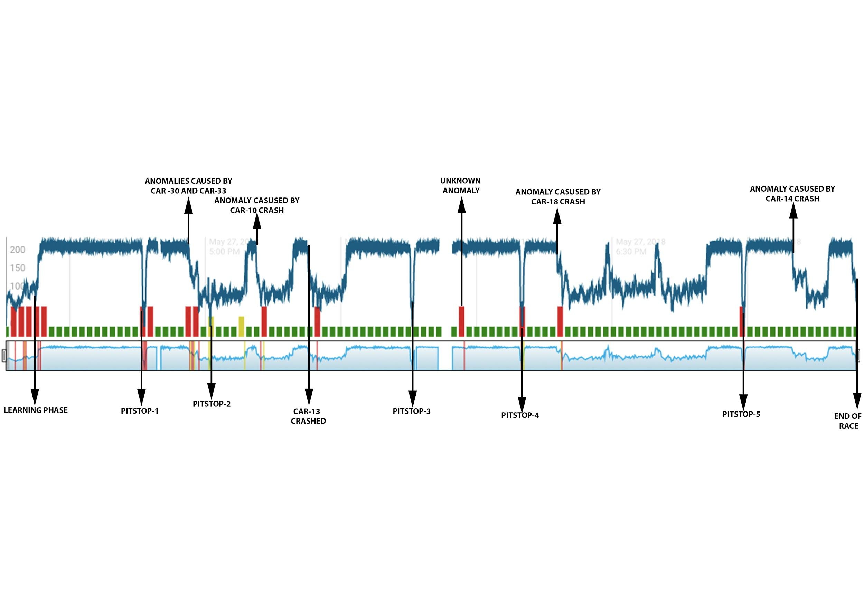
Graph of car -4 after implementing HTM algorithm
Anomalies caused by pit stops and there respective timestamps:
Anomalies caused by car crashes and there respective timestamps:
Car_no: | Anomaly Route Cause | Start time | End time
4 | unknown | 04:43:53 | 04:44:06
4 | pit stop-1 | 16:46:01.01 | 16:47:06.06
4 | pit stop-2 | 17:01:05.05 | 17:01:49.49
4 | unknown | 17:54:48.48 | 17:54:50.50
4 | pit stop-3 | 17:45:46.46 | 17:45:53.53
4 | pit stop-4 | 18:10:03.03 | 18:10:11.11
4 | pit stop-5 | 18:59:06.06 | 18:59:13.13
Car_no: | Anomaly Route Cause | Start time | End Time
4 | Anomaly caused by car-33 & car-30 crash | 16:56:32 | Followed by a pit stop
4 | crash car-10 | 17:11:26 | 17:19:15
4 | crash car-13 | 17:23:07 | 17:24:00
4 | crash car - 18 | 18:17:52 | 18:19:43
4 | crash car -14 | 19:10:18 | 19:17:47

Slide 14
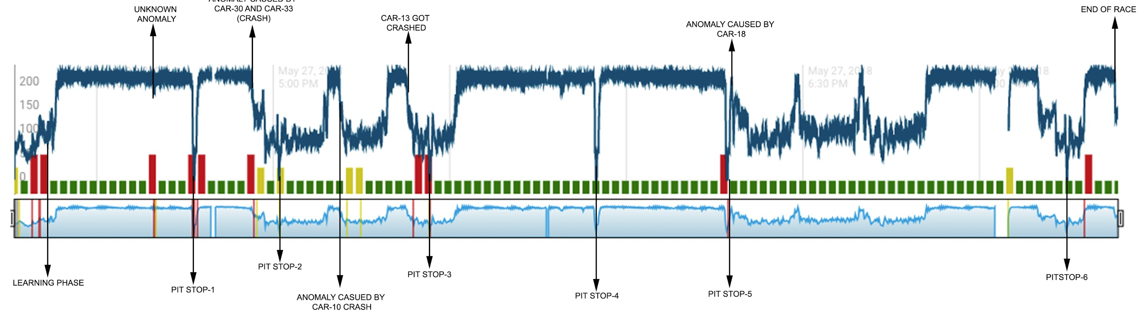
Graph of car -6 after implementing HTM algorithm
Anomalies caused by pit stops and there respective timestamps:
Anomalies caused by car crashes and there respective timestamps:
Car_no: | Anomaly Route Cause | Start time | End time
6 | unknown | 16:39:40.40 | 16:39:52.52
6 | pit stop-1 | 16:46:31.31 | 16:46:36.36
6 | pit stop-2 | 17:00:57.57 | 17:01:02.02
6 | pit stop-3 | 17:26:35.35 | 17:26:40.40
6 | pit stop-4 | 17:54:51.51 | 17:54:57.57
6 | pit stop-5 | 18:17:04.04 | 18:17:12.12
6 | pit stop-6 | 19:14:49.49 | 19:14:55.55
Car_no: | Anomaly Route Cause | Start time | End Time
6 | Anomaly caused by car-33 & car-30 crash | 16:56:32 | Followed by a pit stop
6 | crash car-10 | 17:11:26 | 17:19:15
6 | crash car-13 | 17:23:07 | 05:24:00
6 | crash car - 18 | 18:17:52 | 18:19:43

Slide 15
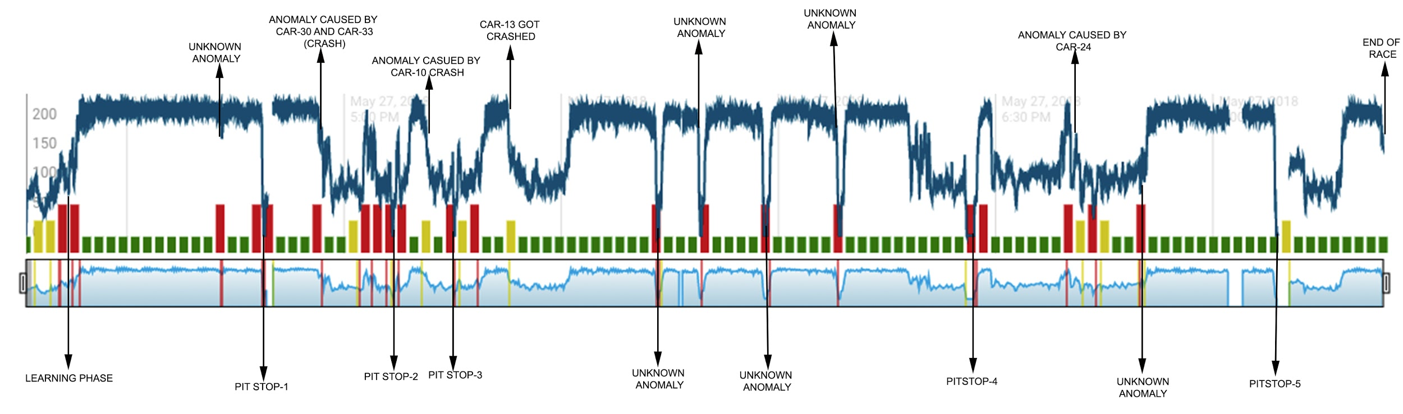
Graph of car -7 after implementing HTM algorithm
Anomalies caused by pit stops and there respective timestamps:
Anomalies caused by car crashes and there respective timestamps:
Car_no: | Anomaly Route Cause | Start time | End time
7 | unknown | 16:43:04.04 | 16:43:18.18
7 | pit stop-1 | 16:48:53.53 | 16:49:03.03
7 | pit stop-2 | 17:06:41.41 | 17:06:47.47
7 | pit stop-3 | 17:15:15.15 | 17:15:17.17
7 | pit stop-4 | 18:26:01.01 | 18:27:01.01
7 | pit stop-5 | 19:08:45.45 | 18:59:41.41
7 | unknown | 18:08:22.22 | 18:08:37.37
Car_no: | Anomaly Route Cause | Start time | End Time
7 | Anomaly caused by car-33 & car-30 crash | 16:56:32 | Followed by a pit stop
7 | crash car-10 | 17:11:26 | 17:19:15
7 | crash car-13 | 17:23:07 | 05:24:00
7 | unknown | 17:43:18.18 | 17:43:23.23
7 | unknown | 17:49:12.12 | 17:49:23.23
7 | crash car-24 | 18:40:55 | 18:50:49
7 | unknown | 17:58:02.02 | 17:58:25.25
7 | unknown | 18:48:58.58 | 18:49:51.51

Slide 16
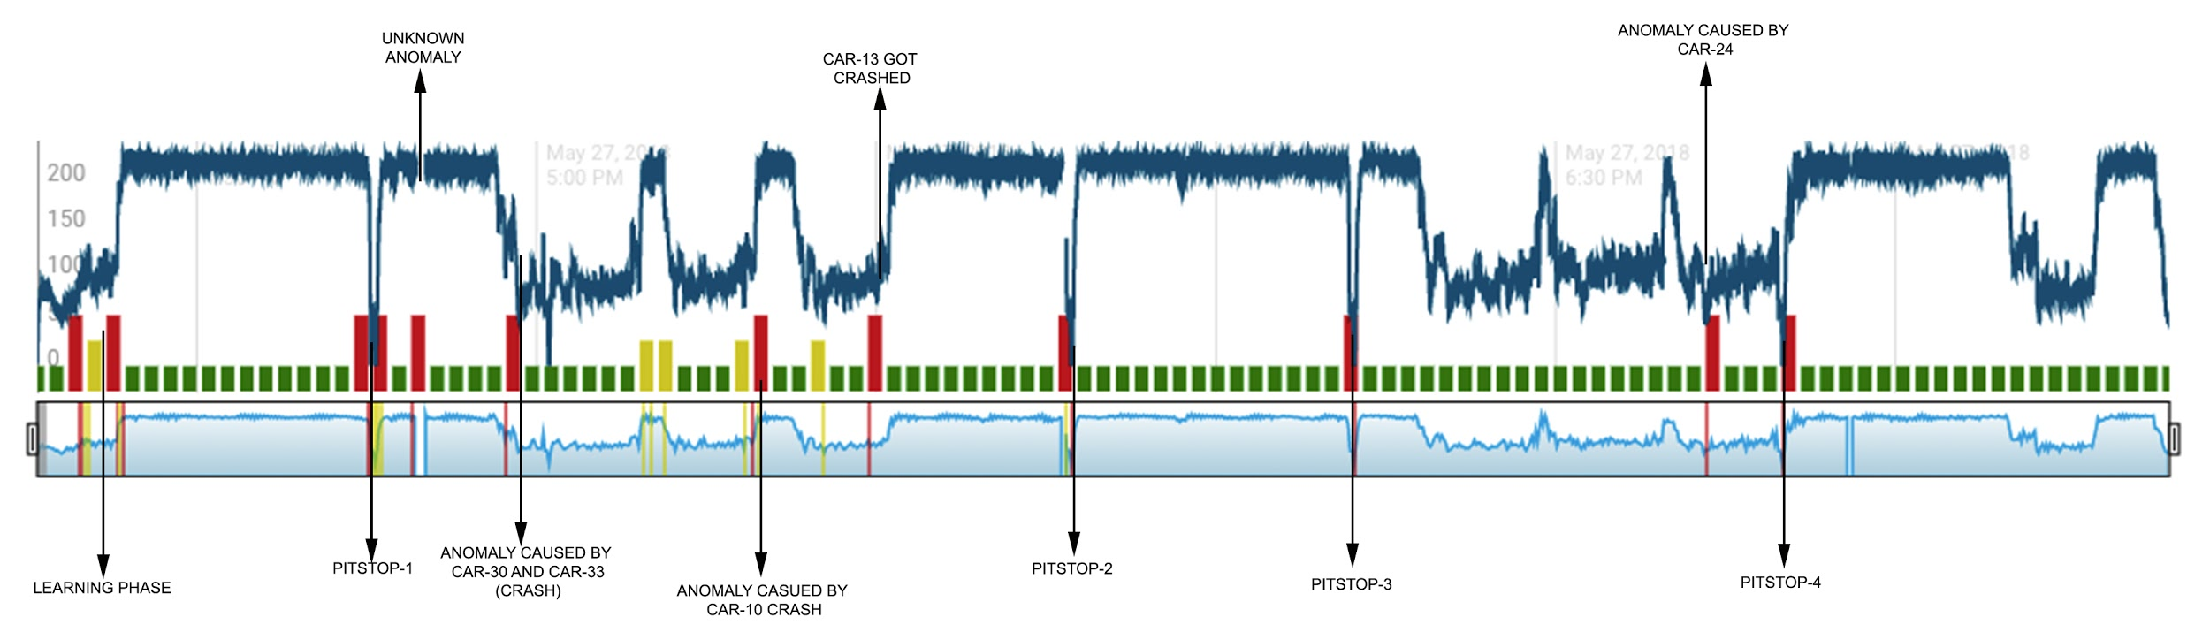
Graph of car -9 after implementing HTM algorithm
Anomalies caused by pit stops and there respective timestamps:
Anomalies caused by car crashes and there respective timestamps:
Car_no: | Anomaly Route Cause | Start time | End time
9 | unknown | 16:48:51.51 | 16:48:54.54
9 | pit stop-1 | 16:45:44.44 | 16:45:50.50
9 | pit stop-2 | 17:47:13.13 | 17:47:18.18
9 | pit stop-3 | 18:12:11.11 | 18:12:16.16
9 | pit stop-4 | 18:50:01.01 | 18:09:58.58
9 | pit stop-5 | 18:59:38.38 | 18:50:08.08
Car_no: | Anomaly Route Cause | Start time | End Time
9 | Anomaly caused by car-33 & car-30 crash | 16:56:32 | Followed by a pit stop
9 | crash car-10 | 17:11:26 | 17:19:15
9 | crash car-13 | 17:23:07 | 05:24:00
9 | crash car-24 | 18:40:55 | 18:50:49

Slide 17
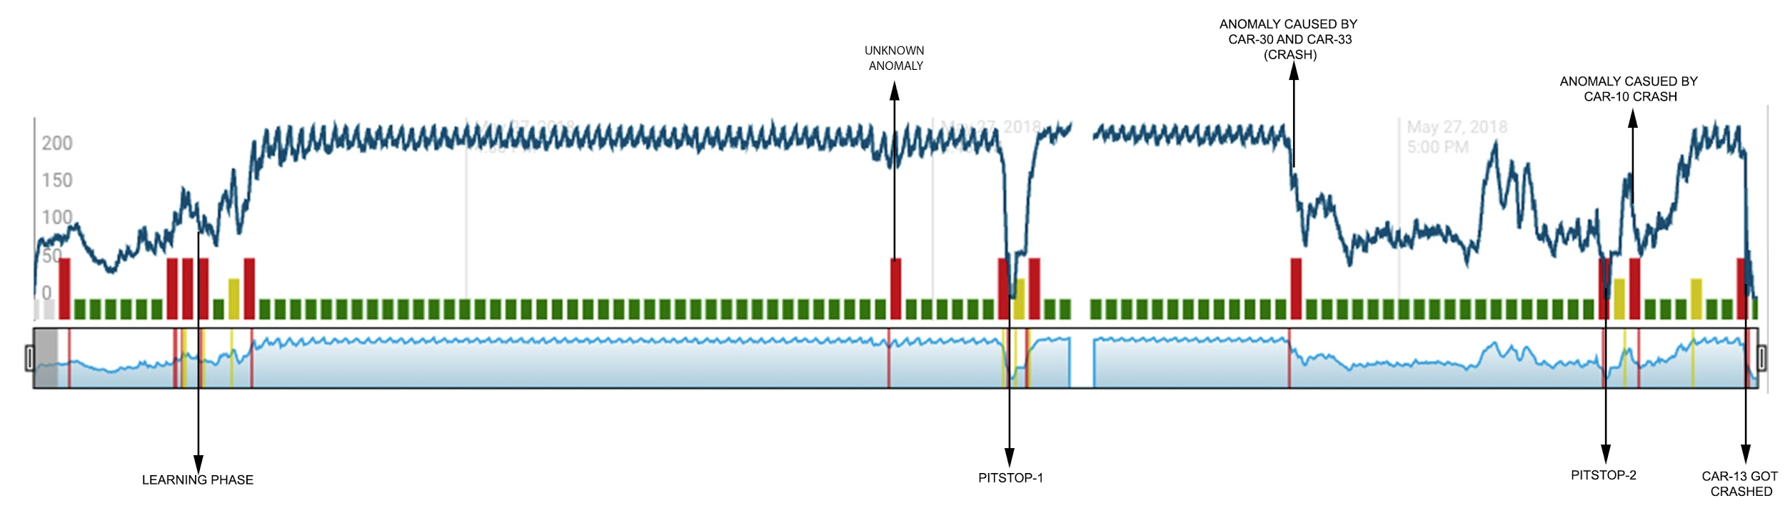
Graph of car -10 after implementing HTM algorithm
Anomalies caused by pit stops and there respective timestamps:
Anomalies caused by car crashes and there respective timestamps:
Car_no: | Anomaly Route Cause | Start time | End time
10 | unknown | 16:43:29.29 | 16:43:42.42
10 | pit stop-1 | 16:47:31.31 | 16:47:37.37
10 | pit stop-2 | 17:06:41.41 | 17:06:44.44
Car_no: | Anomaly Route Cause | Start time | End Time
10 | Anomaly caused by car-33 & car-30 crash | 16:56:32 | Followed by a pit stop
10 | crash car-10 | 17:11:26 | 17:19:15

Slide 18
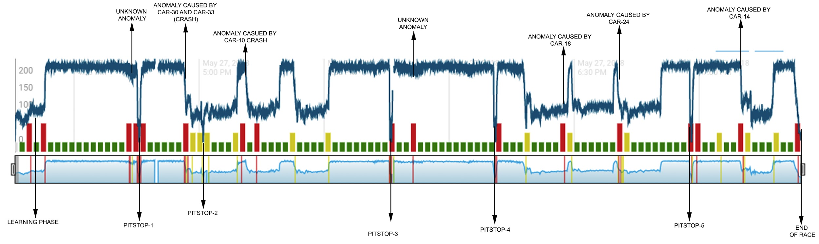
Graph of car -12 after implementing HTM algorithm
Anomalies caused by pit stops and there respective timestamps:
Anomalies caused by car crashes and there respective timestamps:
Car_no: | Anomaly Route Cause | Start time | End time
12 | unknown | 16:43:51.51 | 16:44:06.06
12 | pit stop-1 | 16:45:37.37 | 16:45:43.43
12 | pit stop-2 | 17:00:57.57 | 17:01:02.02
12 | pit stop-3 | 17:46:05.05 | 17:46:11.11
12 | pit stop-4 | 18:11:05.05 | 18:11:11.11
12 | pit stop-5 | 18:58:09.09 | 18:58:15.15
12 | unknown | 17:52:06.06 | 17:52:09.09
Car_no: | Anomaly Route Cause | Start time | End Time
12 | Anomaly caused by car-33 & car-30 crash | 16:56:32 | Followed by a pit stop
12 | crash car-10 | 17:11:26 | 17:19:15
12 | crash car-13 | 17:23:07 | 05:24:00
12 | crash car - 18 | 18:17:52 | 18:19:43
12 | crash car-24 | 18:40:55 | 18:50:49
12 | crash car -14 | 19:10:18 | 19:17:47

Slide 19
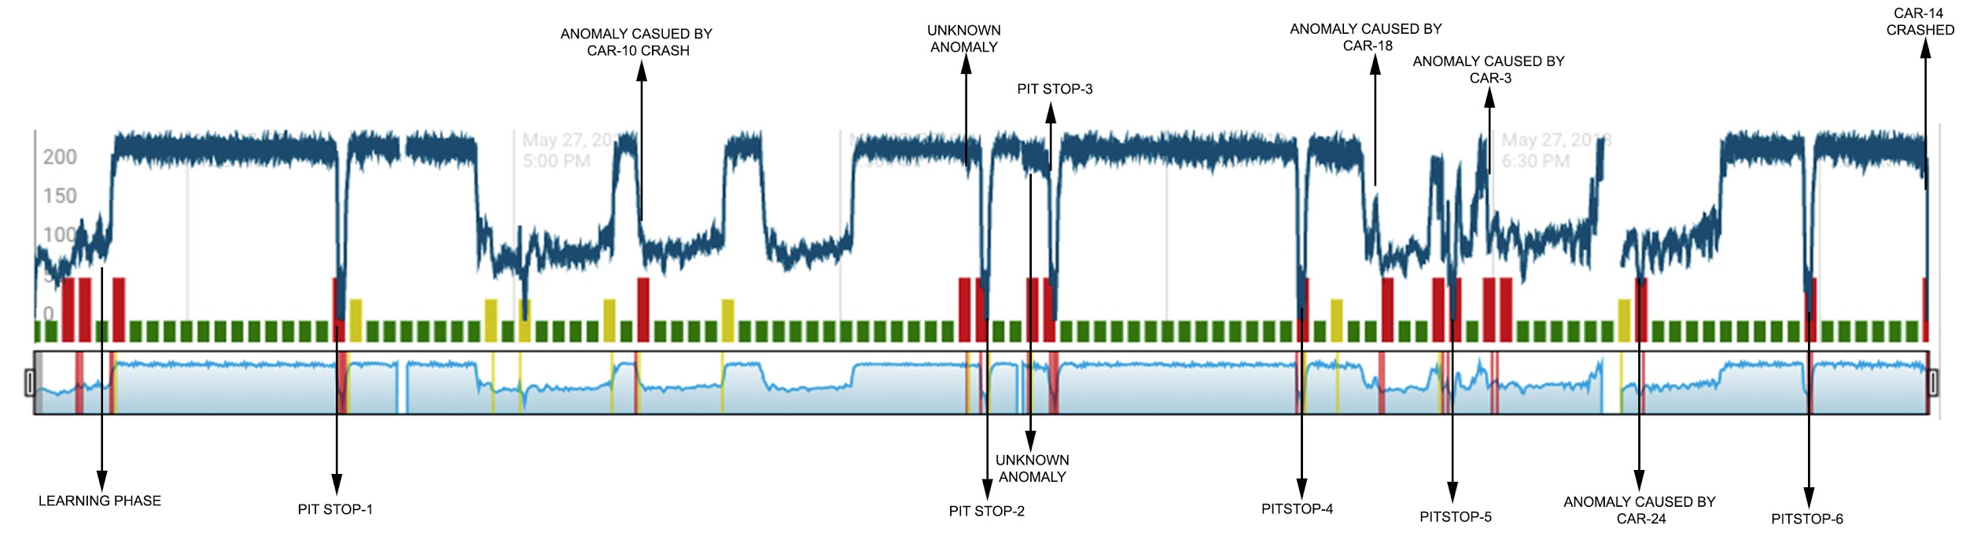
Graph of car -14 after implementing HTM algorithm
Anomalies caused by pit stops and there respective timestamps:
Anomalies caused by car crashes and there respective timestamps:
Car_no: | Anomaly Route Cause | Start time | End time
14 | unknown | 17:41:47.47 | 17:41:51.51
14 | pit stop-1 | 16:44:14.14 | 16:44:21.21
14 | pit stop-2 | 17:43:24.24 | 17:43:30.30
14 | pit stop-3 | 17:49:41.41 | 17:49:47.47
14 | pit stop-4 | 18:09:53.53 | 18:09:58.58
14 | pit stop-5 | 18:59:38.38 | 18:59:41.41
14 | pit stop-6 | 18:59:01.01 | 18:59:08.08
Car_no: | Anomaly Route Cause | Start time | End Time
14 | Anomaly caused by car-33 & car-30 crash | 16:56:32 | Followed by a pit stop
14 | crash car-10 | 17:11:26 | 17:19:15
14 | crash car-13 | 17:23:07 | 05:24:00
14 | crash car - 18 | 18:17:52 | 18:19:43
14 | crash car - 3 | 18:29:26 | 18:38:46
14 | crash car-24 | 18:40:55 | 18:50:49
14 | crash car -14 | 19:10:18 | 19:17:47
14 | unknown | 17:47:11.11 | 17:47:14.14

Slide 20
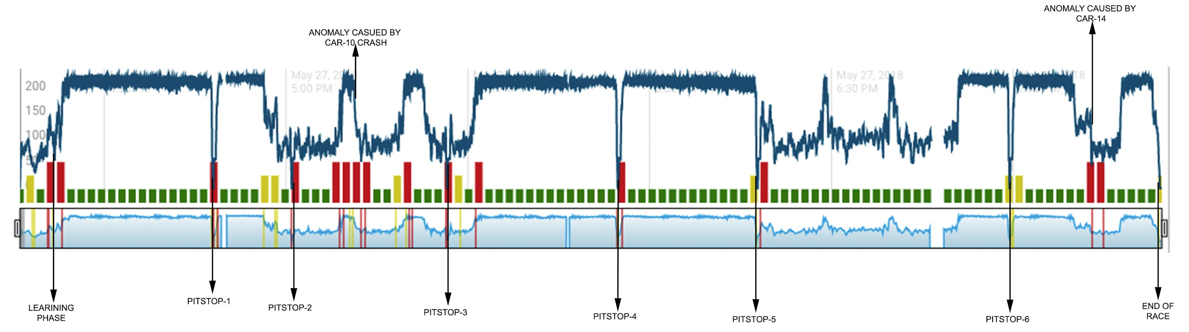
Graph of car -15 after implementing HTM algorithm
Anomalies caused by pit stops and there respective timestamps:
Anomalies caused by car crashes and there respective timestamps:
Car_no: | Anomaly Route Cause | Start time | End time
15 | unknown | 16:43:27.27 | 16:43:42.42
15 | pit stop-1 | 16:47:57.57 | 16:48:03.03
15 | pit stop-2 | 17:00:55.55 | 17:01:01.01
15 | pit stop-3 | 17:26:34.34 | 17:26:40.40
15 | pit stop-4 | 17:54:46.46 | 17:54:51.51
15 | pit stop-5 | 18:17:45.45 | 18:17:51.51
15 | pit stop-6 | 18:59:24.24 | 18:59:30.30
Car_no: | Anomaly Route Cause | Start time | End Time
15 | crash car-10 | 17:11:26 | 17:19:15
15 | crash car -14 | 19:10:18 | 19:17:47

Slide 21
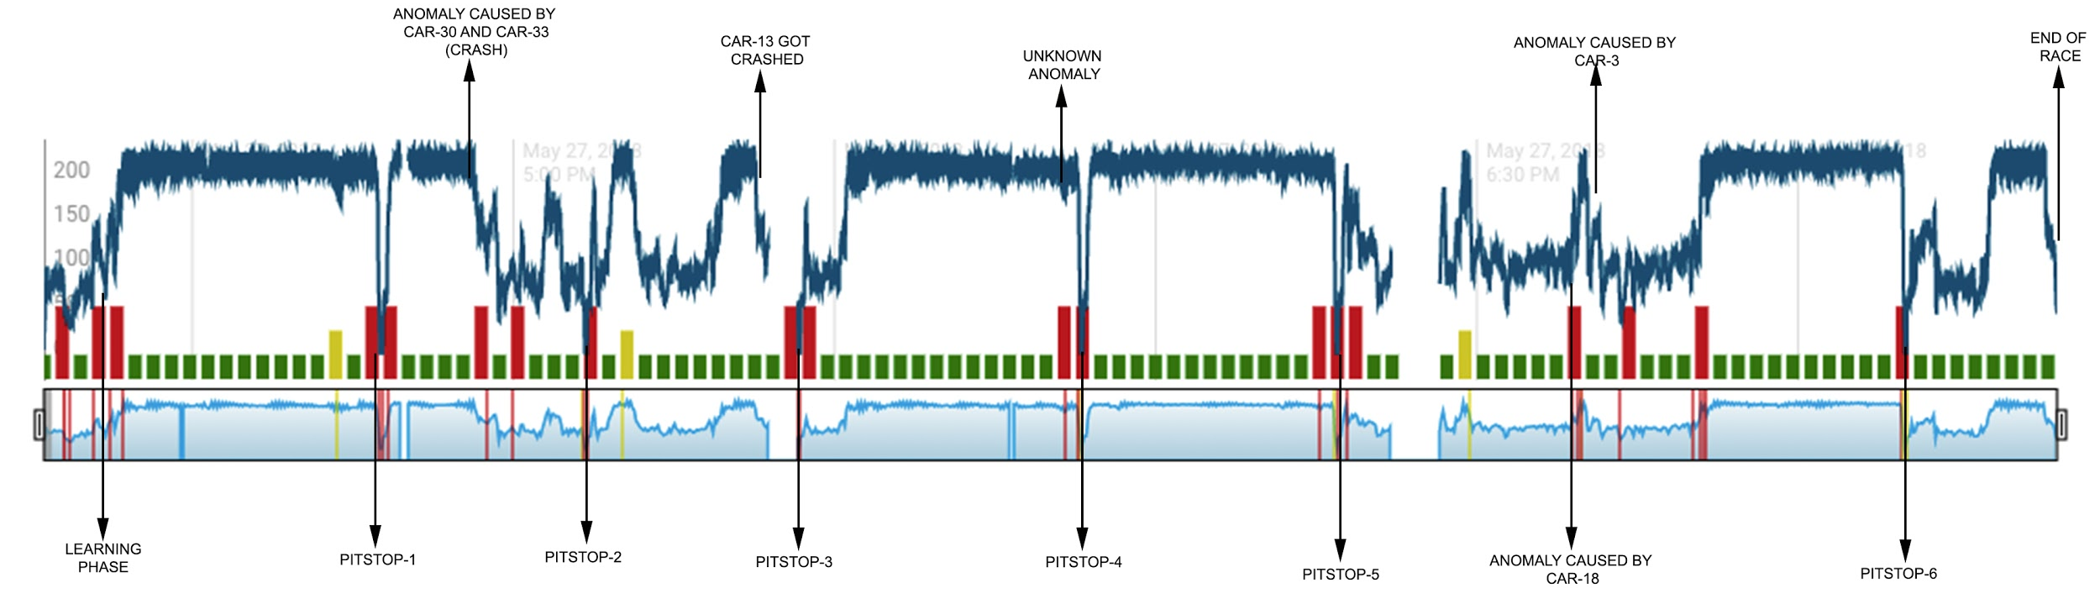
Graph of car -17 after implementing HTM algorithm
Anomalies caused by pit stops and there respective timestamps:
Anomalies caused by car crashes and there respective timestamps:
Car_no: | Anomaly Route Cause | Start time | End time
17 | unknown | 17:51:07.07 | 17:51:12.12
17 | pit stop-1 | 16:47:33.33 | 16:47:47.47
17 | pit stop-2 | 17:06:41.41 | 17:06:51.51
17 | pit stop-3 | 17:26:39.39 | 17:26:47.47
17 | pit stop-4 | 17:53:01.01 | 17:53:11.11
17 | pit stop-5 | 18:16:53.53 | 18:17:02.02
17 | pit stop-6 | 19:09:59.59 | 19:10:09.09
Car_no: | Anomaly Route Cause | Start time | End Time
17 | Anomaly caused by car-33 & car-30 crash | 16:56:32 | Followed by a pit stop
17 | crash car-13 | 17:23:07 | 05:24:00
17 | crash car - 3 | 18:29:26 | 18:38:46

Slide 22
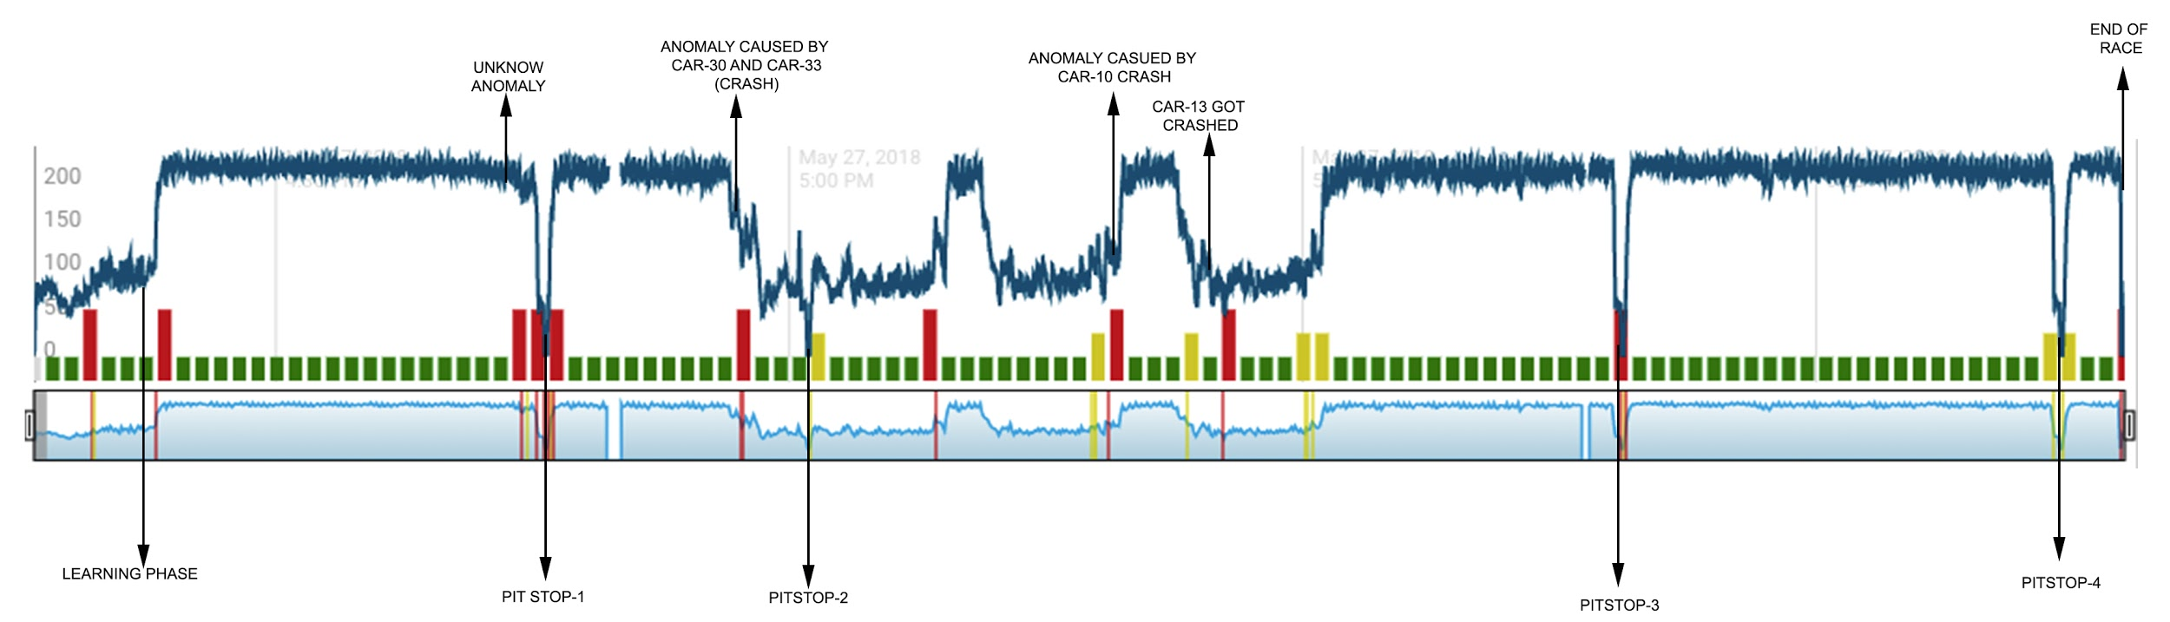
Graph of car -18 after implementing HTM algorithm
Anomalies caused by pit stops and there respective timestamps:
Anomalies caused by car crashes and there respective timestamps:
Car_no: | Anomaly Route Cause | Start time | End time
18 | unknown | 16:44:02.02 | 16:44:06.06
18 | pit stop-1 | 16:45:44.44 | 16:45:50.50
18 | pit stop-2 | 17:01:04.04 | 17:01:11.11
18 | pit stop-3 | 17:48:38.38 | 17:48:46.46
18 | pit stop-4 | 18:14:17.17 | 18:14:25.25
Car_no: | Anomaly Route Cause | Start time | End Time
18 | Anomaly caused by car-33 & car-30 crash | 16:56:32 | Followed by a pit stop
18 | crash car-10 | 17:11:26 | 17:19:15
18 | crash car-13 | 17:23:07 | 05:24:00
18 | crash car - 18 | 18:17:52 | 18:19:43

Slide 23
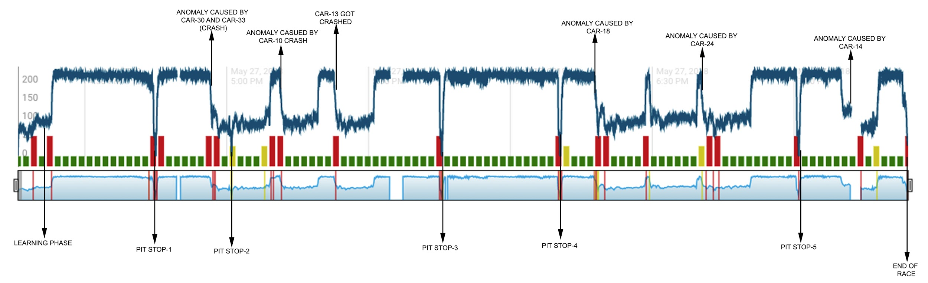
Graph of car -22 after implementing HTM algorithm
Anomalies caused by pit stops and there respective timestamps:
Anomalies caused by car crashes and there respective timestamps:
Car_no: | Anomaly Route Cause | Start time | End time
22 | unknown | 16:43:27.27 | 16:43:42.42
22 | pit stop-1 | 16:44:54.54 | 16:45:00.00
22 | pit stop-2 | 17:00:58.58 | 17:01:04.04
22 | pit stop-3 | 17:45:28.28 | 17:45:34.34
22 | pit stop-4 | 18:10:29.29 | 18:10:35.35
22 | pit stop-5 | 19:00:58.58 | 19:01:04.04
Car_no: | Anomaly Route Cause | Start time | End Time
22 | Anomaly caused by car-33 & car-30 crash | 16:56:32 | Followed by a pit stop
22 | crash car-10 | 17:11:26 | 17:19:15
22 | crash car-13 | 17:23:07 | 05:24:00
22 | crash car - 18 | 18:17:52 | 18:19:43
22 | crash car-24 | 18:40:55 | 18:50:49
22 | crash car -14 | 19:10:18 | 19:17:47

Slide 24
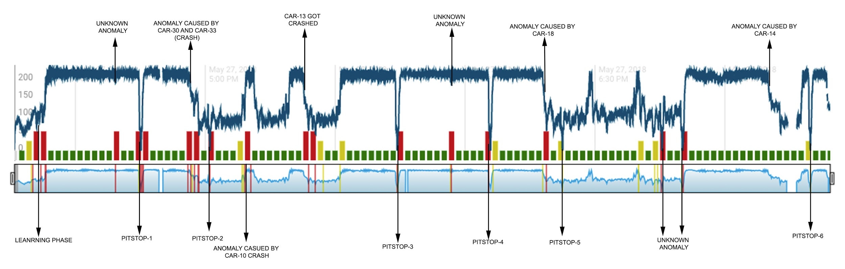
Graph of car -23 after implementing HTM algorithm
Anomalies caused by pit stops and there respective timestamps:
Anomalies caused by car crashes and there respective timestamps:
Car_no: | Anomaly Route Cause | Start time | End time
23 | unknown | 16:39:18.18 | 16:39:22.22
23 | pit stop-1 | 16:45:05.05 | 16:45:11.11
23 | pit stop-2 | 17:01:01.01 | 17:01:06.06
23 | pit stop-3 | 17:44:18.18 | 17:44:27.27
23 | pit stop-4 | 18:05:47.47 | 18:05:55.55
23 | pit stop-5 | 18:22:27.27 | 18:22:33.33
23 | pit stop-6 | 19:19:43.43 | 19:19:47.47
Car_no: | Anomaly Route Cause | Start time | End Time
23 | Anomaly caused by car-33 & car-30 crash | 16:56:32 | Followed by a pit stop
23 | crash car-10 | 17:11:26 | 17:19:15
23 | crash car-13 | 17:23:07 | 05:24:00
23 | crash car - 18 | 18:17:52 | 18:19:43
23 | crash car -14 | 19:10:18 | 19:17:47
23 | unknown | 18:45:27.27 | 18:45:33.33
23 | unknown | 18:50:08.08 | 18:50:17.17

Slide 25
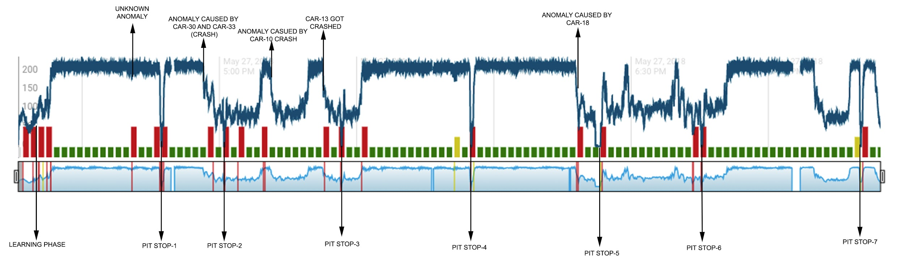
Graph of car -25 after implementing HTM algorithm
Anomalies caused by pit stops and there respective timestamps:
Anomalies caused by car crashes and there respective timestamps:
Car_no: | Anomaly Route Cause | Start time | End time
25 | unknown | 16:40:34.34 | 16:40:36.36
25 | pit stop-1 | 16:47:17.17 | 16:47:24.24
25 | pit stop-2 | 17:00:58.58 | 17:01:06.06
25 | pit stop-3 | 17:26:39.39 | 17:26:45.45
25 | pit stop-4 | 17:55:01.01 | 17:55:08.08
25 | pit stop-5 | 18:22:42.42 | 18:23:18.18
25 | pit stop-6 | 18:45:21.21 | 18:45:31.31
Car_no: | Anomaly Route Cause | Start time | End Time
25 | Anomaly caused by car-33 & car-30 crash | 16:56:32 | Followed by a pit stop
25 | crash car-10 | 17:11:26 | 17:19:15
25 | crash car-13 | 17:23:07 | 05:24:00
25 | crash car - 18 | 18:17:52 | 18:19:43
25 | pit stop-7 | 19:20:12.12 | 19:20:14.14

Slide 26
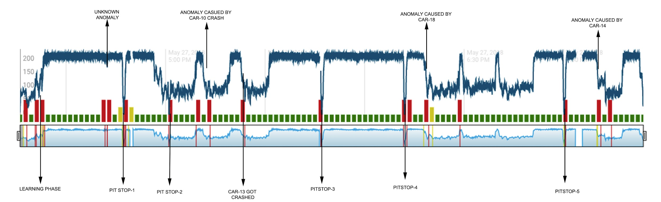
Graph of car -27 after implementing HTM algorithm
Anomalies caused by pit stops and there respective timestamps:
Anomalies caused by car crashes and there respective timestamps:
Car_no: | Anomaly Route Cause | Start time | End time
27 | unknown | 16:41:34.34 | 16:41:37.37
27 | pit stop-1 | 16:47:19.19 | 16:47:26.26
27 | pit stop-2 | 17:01:02.02 | 17:01:08.08
27 | pit stop-3 | 17:47:04.04 | 17:47:11.11
27 | pit stop-4 | 18:12:03.03 | 18:12:10.10
27 | pit stop-5 | 19:00:07.07 | 19:00:12.12
Car_no: | Anomaly Route Cause | Start time | End Time
27 | Anomaly caused by car-33 & car-30 crash | 16:56:32 | Followed by a pit stop
27 | crash car-13 | 17:23:07 | 05:24:00
27 | crash car - 18 | 18:17:52 | 18:19:43
27 | crash car-24 | 18:40:55 | 18:50:49

Slide 27
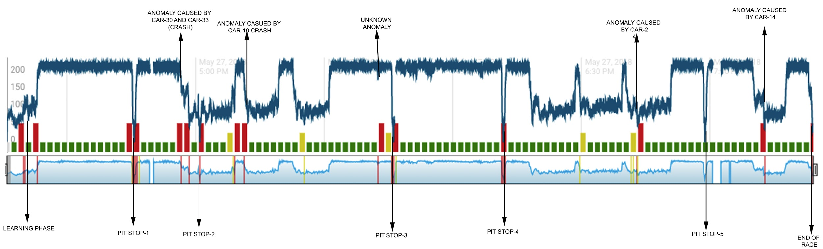
Graph of car -28 after implementing HTM algorithm
Anomalies caused by pit stops and there respective timestamps:
Anomalies caused by car crashes and there respective timestamps:
Car_no: | Anomaly Route Cause | Start time | End time
28 | unknown | 17:42:48.48 | 17:42:50.50
28 | pit stop-1 | 16:45:37.37 | 16:45:42.42
28 | pit stop-2 | 17:00:57.57 | 17:01:02.02
28 | pit stop-3 | 17:46:06.06 | 17:46:12.12
28 | pit stop-4 | 18:11:46.46 | 18:11:52.52
28 | pit stop-5 | 18:58:49.49 | 18:58:51.51
Car_no: | Anomaly Route Cause | Start time | End Time
28 | Anomaly caused by car-33 & car-30 crash | 16:56:32 | Followed by a pit stop
28 | crash car-10 | 17:11:26 | 17:19:15
28 | crash car-24 | 18:40:55 | 18:50:49
28 | crash car -14 | 19:10:18 | 19:17:47

Slide 28
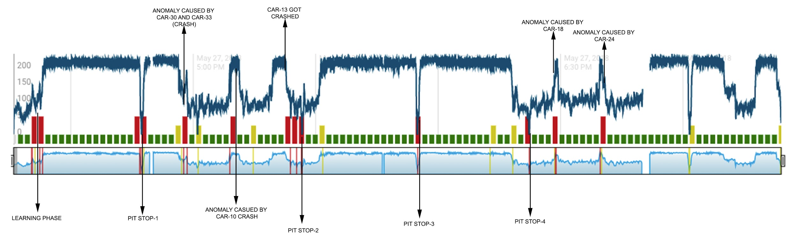
Graph of car -29 after implementing HTM algorithm
Anomalies caused by pit stops and there respective timestamps:
Anomalies caused by car crashes and there respective timestamps:
Car_no: | Anomaly Route Cause | Start time | End time
29 | unknown | 16:43:27.27 | 16:43:42.42
29 | pit stop-1 | 16:47:18.18 | 16:47:25.25
29 | pit stop-2 | 17:26:37.37 | 17:26:43.43
29 | pit stop-3 | 17:54:53.53 | 17:55:00.00
29 | pit stop-4 | 18:22:16.16 | 18:22:23.23
Car_no: | Anomaly Route Cause | Start time | End Time
29 | Anomaly caused by car-33 & car-30 crash | 16:56:32 | Followed by a pit stop
29 | crash car-10 | 17:11:26 | 17:19:15
29 | crash car-13 | 17:23:07 | 05:24:00
29 | crash car - 18 | 18:17:52 | 18:19:43
29 | crash car-24 | 18:40:55 | 18:50:49

Slide 29
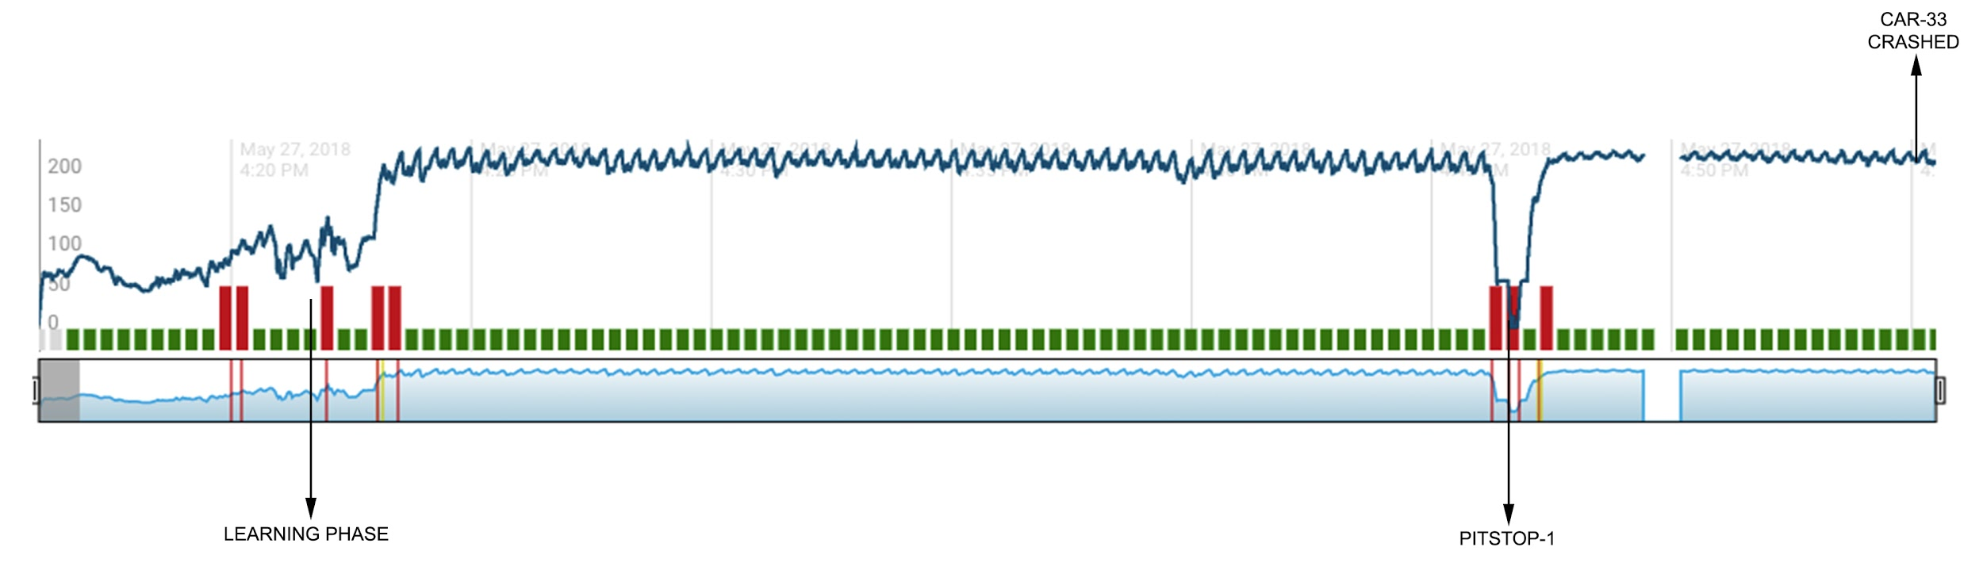
Graph of car -30 after implementing HTM algorithm
Anomalies caused by pit stops and there respective timestamps:
Anomalies caused by car crashes and there respective timestamps:
Car_no: | Anomaly Route Cause | Start time | End time
30 | pit stop-1 | 16:46:39.39 | 16:46:46.46
Car_no: | Anomaly Route Cause | Start time | End Time
30 | Anomaly caused by car-33 & car-30 crash | 16:56:32 | Followed by a pit stop

Slide 30
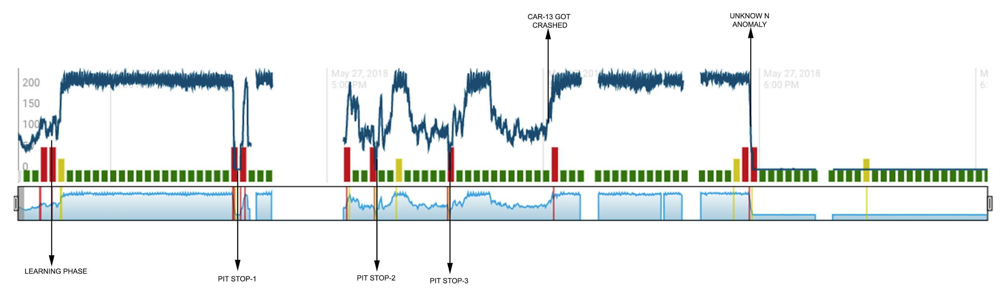
Graph of car -32 after implementing HTM algorithm
Anomalies caused by pit stops and there respective timestamps:
Anomalies caused by car crashes and there respective timestamps:
Car_no: | Anomaly Route Cause | Start time | End time
32 | pit stop-1 | 16:47:17.17 | 16:47:58.58
32 | pit stop-2 | 17:06:43.43 | 17:06:50.50
32 | pit stop-3 | 17:17:00.00 | 17:17:03.03
Car_no: | Anomaly Route Cause | Start time | End Time
32 | crash car-13 | 17:23:07 | 05:24:00
32 | Unknown | 17:59:05.05 | --

Slide 31
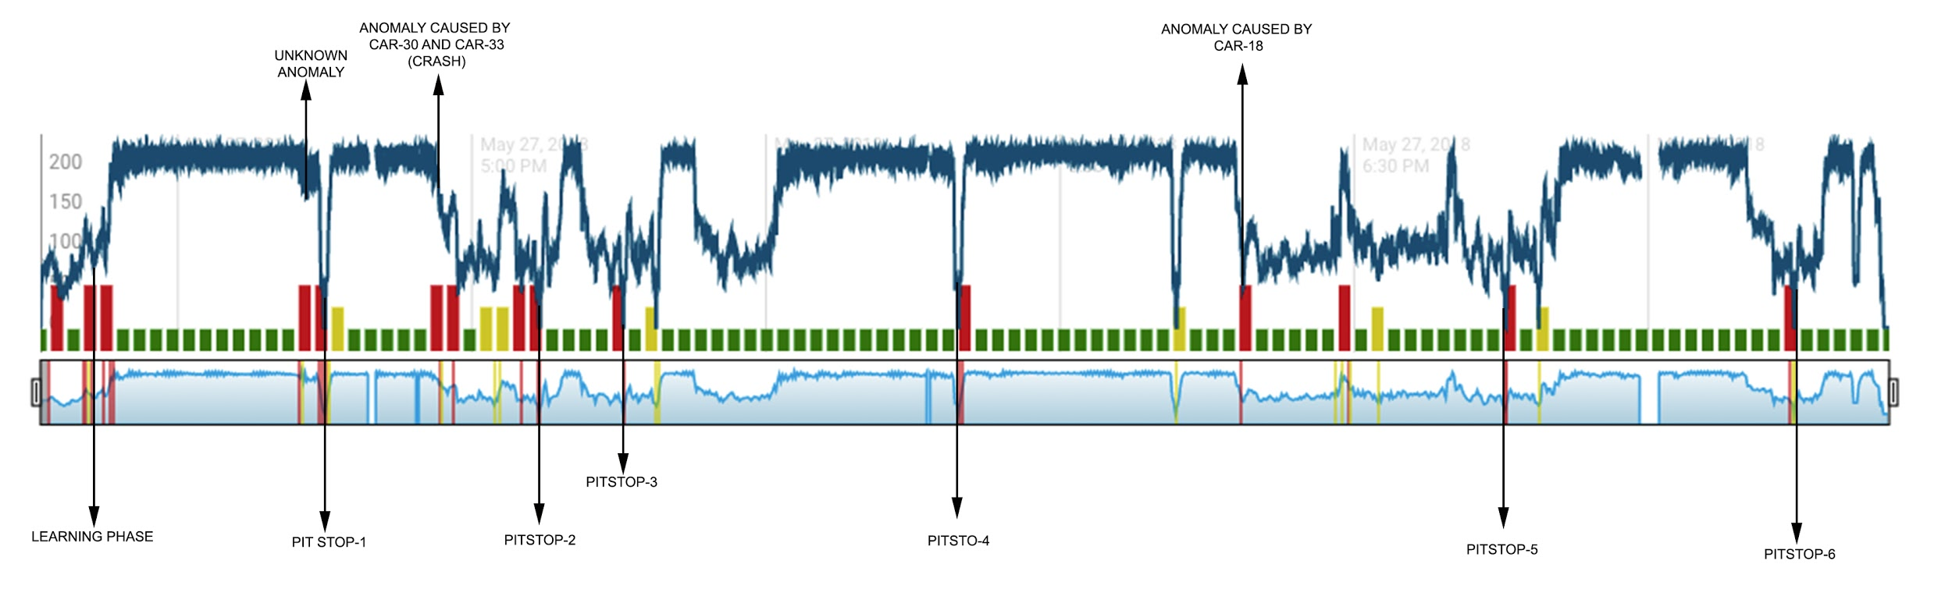
Graph of car -59 after implementing HTM algorithm
Anomalies caused by pit stops and there respective timestamps:
Anomalies caused by car crashes and there respective timestamps:
Car_no: | Anomaly Route Cause | Start time | End time
59 | unknown | 16:42:24.24 | 16:42:30.30
59 | pit stop-1 | 16:44:52.52 | 16:45:03.03
59 | pit stop-2 | 17:06:51.51 | 17:06:57.57
59 | pit stop-3 | 17:15:27.27 | 17:15:29.29
59 | pit stop-4 | 17:49:34.34 | 17:49:42.42
59 | pit stop-5 | 18:45:23.23 | 18:45:28.28
59 | pit stop-6 | 19:14:52.52 | 19:14:59.59
Car_no: | Anomaly Route Cause | Start time | End Time
59 | Anomaly caused by car-33 & car-30 crash | 16:56:32 | Followed by a pit stop
59 | crash car - 18 | 18:17:52 | 18:19:43

Slide 32
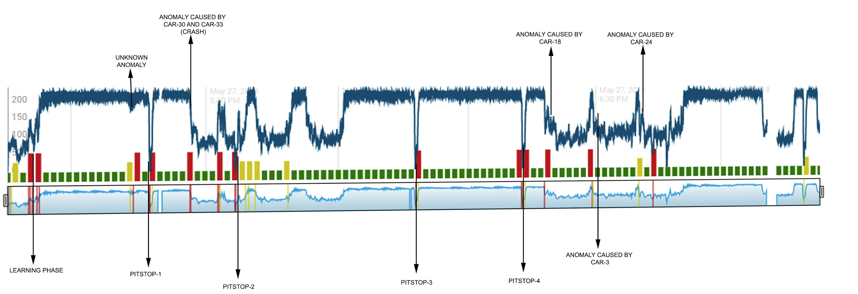
Graph of car -60 after implementing HTM algorithm
Anomalies caused by pit stops and there respective timestamps:
Anomalies caused by car crashes and there respective timestamps:
Car_no: | Anomaly Route Cause | Start time | End time
60 | unknown | 16:43:50.50 | 16:44:01.01
60 | pit stop-1 | 16:47:26.26 | 16:47:33.33
60 | pit stop-2 | 17:06:37.37 | 17:06:43.43
60 | pit stop-3 | 17:47:41.41 | 17:47:49.49
60 | pit stop-4 | 18:12:43.43 | 18:12:50.50
Car_no: | Anomaly Route Cause | Start time | End Time
60 | Anomaly caused by car-33 & car-30 crash | 16:56:32 | Followed by a pit stop
60 | crash car - 18 | 18:17:52 | 18:19:43
60 | crash car - 3 | 18:29:26 | 18:38:46
60 | crash car-24 | 18:40:55 | 18:50:49
60 | crash car -14 | 19:10:18 | 19:17:47

Slide 33
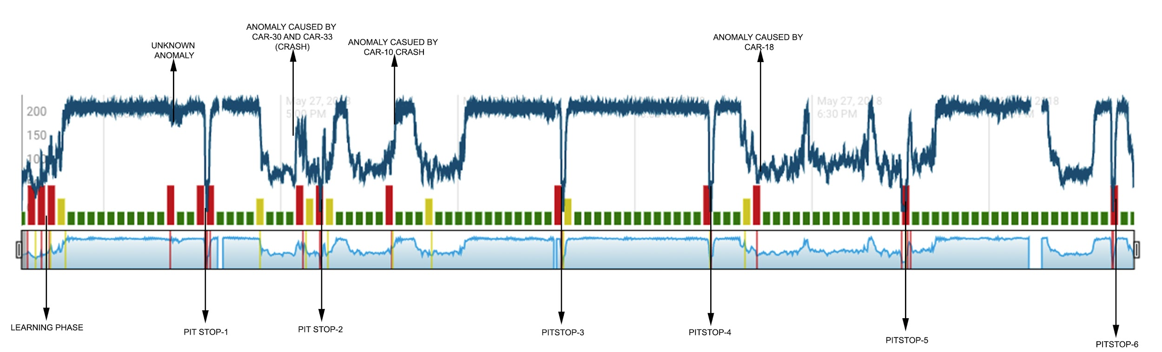
Graph of car -64 after implementing HTM algorithm
Anomalies caused by pit stops and there respective timestamps:
Anomalies caused by car crashes and there respective timestamps:
Car_no: | Anomaly Route Cause | Start time | End time
64 | unknown | 16:42:40.40 | 16:42:55.55
64 | pit stop-1 | 16:47:26.26 | 16:47:33.33
64 | pit stop-2 | 17:06:42.42 | 17:06:48.48
64 | pit stop-3 | 17:47:46.46 | 17:47:53.53
64 | pit stop-4 | 18:12:48.48 | 18:12:56.56
64 | pit stop-5 | 18:45:15.15 | 18:45:37.37
64 | pit stop-6 | 19:20:59.59 | 19:21:01.01
Car_no: | Anomaly Route Cause | Start time | End Time
64 | Anomaly caused by car-33 & car-30 crash | 16:56:32 | Followed by a pit stop
64 | crash car-10 | 17:11:26 | 17:19:15
64 | crash car - 18 | 18:17:52 | 18:19:43

Slide 34
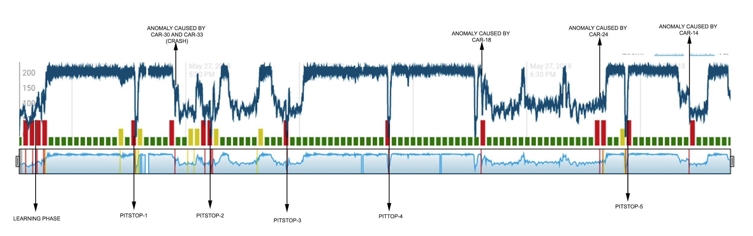
Graph of car -66 after implementing HTM algorithm
Anomalies caused by pit stops and there respective timestamps:
Anomalies caused by car crashes and there respective timestamps:
Car_no: | Anomaly Route Cause | Start time | End time
66 | unknown | 16:43:27.27 | 16:43:42.42
66 | pit stop-1 | 16:46:45.45 | 16:46:55.55
66 | pit stop-2 | 17:06:37.37 | 17:06:44.44
66 | pit stop-3 | 17:26:33.33 | 17:26:41.41
66 | pit stop-4 | 17:53:26.26 | 17:53:32.32
66 | pit stop-5 | 18:56:01.01 | 18:56:07.07
Car_no: | Anomaly Route Cause | Start time | End Time
66 | Anomaly caused by car-33 & car-30 crash | 16:56:32 | Followed by a pit stop
66 | crash car - 18 | 18:17:52 | 18:19:43
66 | crash car-24 | 18:40:55 | 18:50:49
66 | crash car -14 | 19:10:18 | 19:17:47

Slide 35
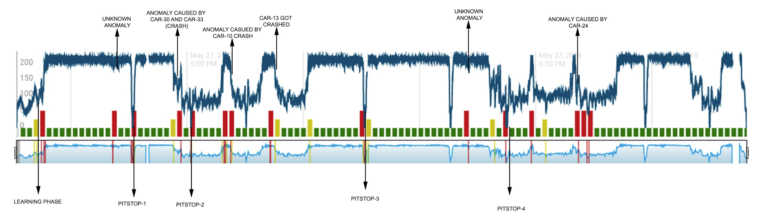
Graph of car -88 after implementing HTM algorithm
Anomalies caused by pit stops and there respective timestamps:
Anomalies caused by car crashes and there respective timestamps:
Car_no: | Anomaly Route Cause | Start time | End time
88 | unknown | 16:42:00.00 | 16:42:06.06
88 | pit stop-1 | 16:45:56.56 | 16:46:04.04
88 | pit stop-2 | 17:01:02.02 | 17:01:08.08
88 | pit stop-3 | 17:45:47.47 | 17:45:54.54
88 | pit stop-4 | 18:22:35.35 | 18:22:41.41
88 | unknown | 18:12:42.42 | 18:12:53.53
Car_no: | Anomaly Route Cause | Start time | End Time
88 | Anomaly caused by car-33 & car-30 crash | 16:56:32 | Followed by a pit stop
88 | crash car-10 | 17:11:26 | 17:19:15
88 | crash car-13 | 17:23:07 | 05:24:00
88 | crash car - 18 | 18:17:52 | 18:19:43
88 | crash car-24 | 18:40:55 | 18:50:49

